Slide 1

Frontend Security Practices: Guarding the Castle
Because Hackers Don’t Take Coffee Breaks!

Slide 2

Why Should We Care?
🕵️‍♂️ What’s the worst that could happen if we ignore security?
A hacker steals all user data 🕵️‍♂️💾
Website defaced with memes 🎭😂
You get fired ☠️🔥
All of the above 💼🚨
💀 Hackers Gone Wild:
British Airways fined £183 million for a frontend security breach in 2018 (Magecart attack).

Slide 3
Common Frontend Security threats
🕵️‍♂️ The Usual Suspects:
Cross-Site Scripting (XSS)
Cross-Site Request Forgery (CSRF)
Clickjacking
Supply Chain Attacks (3rd Party Libraries/ Packges)
Insecure Authentication

Slide 4

Cross-Site Scripting (XSS) - The Sneaky Attacker
🚨 What is XSS?
Attackers inject malicious scripts into web pages viewed by others.
Used to steal data, hijack sessions, manipulate pages, or spread malware.
💀 Hackers Gone Wild:
The MySpace worm (2005) - One XSS attack created 1 million+ friends for a hacker in a single day.

Slide 5
Types of XSS Attacks
1️⃣ Stored XSS (Persistent) – "The Silent Attacker"
Malicious script is stored in a database and served to users.
User comments `<script>alert('Hacked!')</script>` that gets stored in a database.
2️⃣ Reflected XSS – "The Quick Strike"
Malicious script is injected via URLs or input fields and reflected back
<a href="http://victim.com/search?q=<script>alert('Hacked!')</script>">
3️⃣ DOM-Based XSS – "The JavaScript Manipulator"
Happens inside JavaScript execution when it improperly handles user input.
🔗 Code Reference for XSS

Slide 6

Preventing XSS – Best Practices
🔒 How to secure then?
✅ Escape & Encode User Input – React already does this in JSX.
✅ Use textContent instead of innerHTML.
✅ Avoid dangerouslySetInnerHTML
– Use it only when absolutely needed.
✅ Use Content Security Policy (CSP) – Restrict script execution from untrusted sources.
<meta
http-equiv="Content-Security-Policy"
content="default-src 'self'; script-src 'self' https://trustedsource.com;"
>
✅ Validate & Filter Input – Never trust user-provided data.

Slide 7

Cross-Site Request Forgery (CSRF) – The Invisible Imposter
🚨 What is CSRF?
Tricks a user into performing unintended actions while they are authenticated.
Exploits session-based authentication (cookies, tokens, etc.)
Common targets:
Bank transactions, password changes, account settings.
💀 Hackers Gone Wild:
GitHub CSRF (2012) – Attackers could add SSH keys to accounts!
Netflix CSRF – Forced users to change emails & passwords!

Slide 8
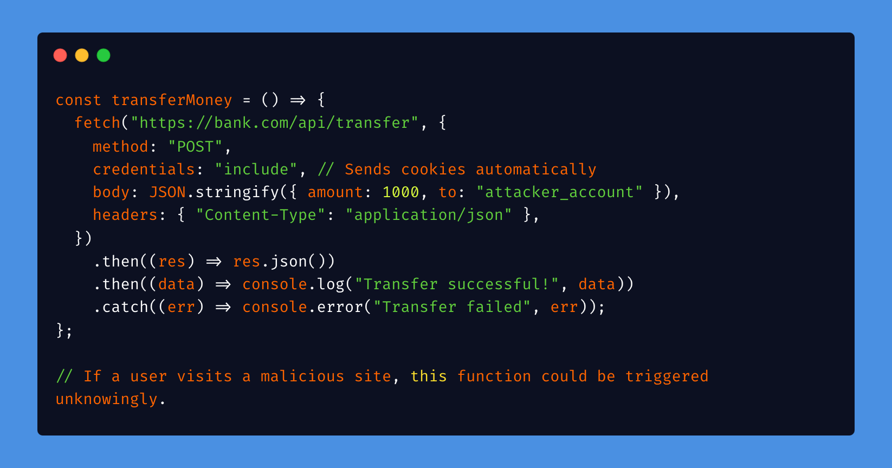
How CSRF Works – A Silent Attack!
User logs in → Session stays active
Attacker tricks them into clicking a malicious link
Action gets executed without consent!
Victim: “Wait… I never did that?!
❌ Vulnerable Code (Without CSRF Protection)

Slide 9

How to fix CSRF in Frontend apps?
✅ Use CSRF Tokens (Most secure way) – CSRF Code Reference 🔗
✅ Set SameSite=strict or SameSite=lax on cookies
✅ Require re-authentication for sensitive actions
✅ Use Referer or Origin header validation in the backend
Why CSRF Tokens Stop This Attack?
Token validation:
Ensures only requests from the real user are accepted.
Stops CSRF attacks:
Even if an attacker tricks the user into clicking a malicious link, the request won’t have the correct CSRF token, so the backend rejects it.

Slide 10

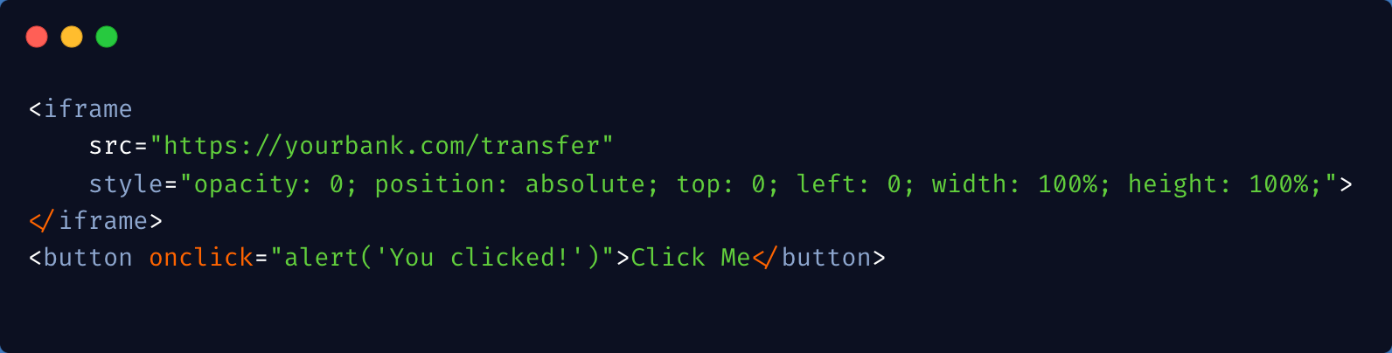
Clickjacking - The "Invisible Button" Trick
What?
A user clicks on a visible button, but an invisible button
(e.g., "Transfer Money") is actually triggered.
How?
🔍 Trick: Attackers embed your website inside an invisible iframe.
💀 Hackers Gone Wild:
Facebook Clickjacking Attack (2011): Users unknowingly liked posts that spread across the platform.
Malicious Website (evil.com):

Slide 11
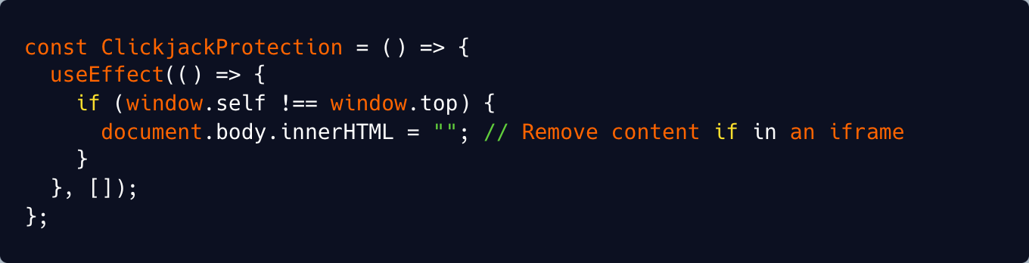
How to Prevent Clickjacking in React Apps?
1. Use X-Frame-Options Header:
2. Use Content-Security-Policy(CSP):
3. Add Clickjacking Detection in React:

Slide 12
Supply Chain Attacks - The Trojan Horse
What happens?
Attackers insert malicious code into open-source libraries, which then spread to thousands of applications.
How It Works?
Compromise a trusted package (e.g., an npm library).
Distribute the malware – developers install it without knowing.
Exploit—Once in the system, the malware can steal credentials, inject backdoors, or perform unauthorized actions.
💀 Hackers Gone Wild:
Event-Stream npm attack(2018): Maintainer unknowingly added a backdoor to steal cryptocurrency.
Prevention:
✅ Use dependency scanning tools (npm audit, Snyk)
✅ Lock dependencies (package-lock.json)
✅ Verify maintainers before installing packages

Slide 13
🚨 What you can do:
Run npm show <package-name> maintainer to check who maintains the package.
Look at GitHub activity:
Are there sudden new owners?
Has the project been inactive for a long time?
Check for warnings on npm (sometimes npm flags compromised packages).
Run npm audit or use tools like Snyk, Dependabot.
An extra prevention tip:
Use npm ci instead of npm install in CI/CD to ensure exact dependency versions.
A single compromised dependency can put an entire company at risk.
Stay vigilant, and remember: ‘npm install’ is a trust exercise!’

Slide 14
Security Headers - Your Website’s Helmet
Must-Have Security Headers:
Content-Security-Policy (CSP)
X-Frame-Options: DENY
Strict-Transport-Security (HSTS)
Referrer-Policy: no-referrer

Slide 15

Final Takeaways
Frontend Security Checklist:
✅ Sanitize user inputs (Prevent XSS)
✅ Protect users from CSRF attacks
✅ Lock down authentication & authorization
✅ Keep dependencies up to date
✅ Set security headers
🎤 Call to Action:
Security is like brushing your teeth – ignore it, and things get ugly!
Hackers don’t take coffee breaks… but neither should our security! ☕💻 🔒

